Slide 1

JavaScript Fundamentals
Course Overview
SoftUni Team
Technical Trainers
Software University
http://softuni.bg

Slide 2
Table of Content
Introduction
Training & Team
Course Objectives
Course Organization

Slide 3
Have a Question?
sli.do
#JS-CORE

Slide 4












SoftUni Diamond Partners

Slide 5




SoftUni Organizational Partners

Slide 6

JS Fundamentals
Course Objectives & Program

Slide 7
JS Fundamentals – Course Topics
1. JavaScript Syntax and Operators - Basic Syntax, Arrays, Functions, Objects, JSON
2. Document Object Model - Explanation of DOM, Selectors, DOM Manipulation, Events
3. Functions and Logic Flow - Functions and arrow functions (lambda)
4. Arrays and Matrices - Arrays and multi-dimensional arrays

Slide 8

JS Fundamentals – Course Topics
5. Strings and RegExp - Strings and regular expressions
6. Objects and JSON. DOM Events - Objects, JSON, associative arrays, sets and maps, DOM elements, handlе events
7. Workshop – HTML5 Games
8. Exam Preparation

Slide 9

Trainers and Team

Slide 10
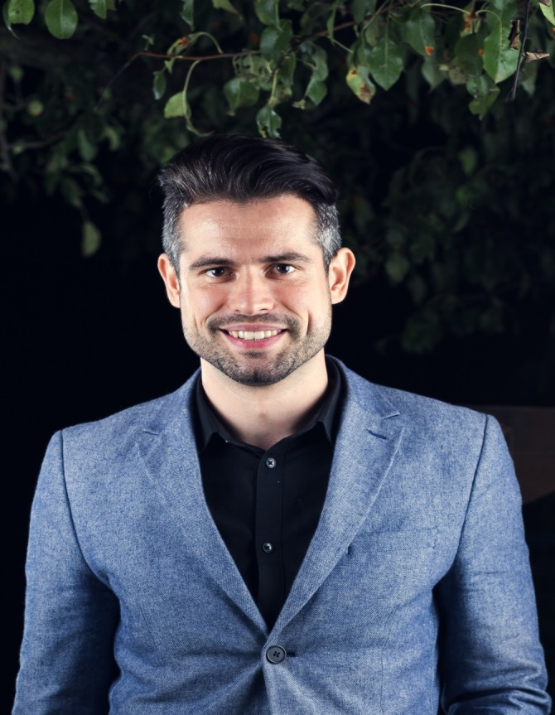
Ivaylo Papazov
Full-Stack Developer in SoftUni
Technical Trainer in SoftUni
Experience in JS, C#, Node.js, React, ASP.NET MVC
TelerikAcademy Graduate

Slide 11
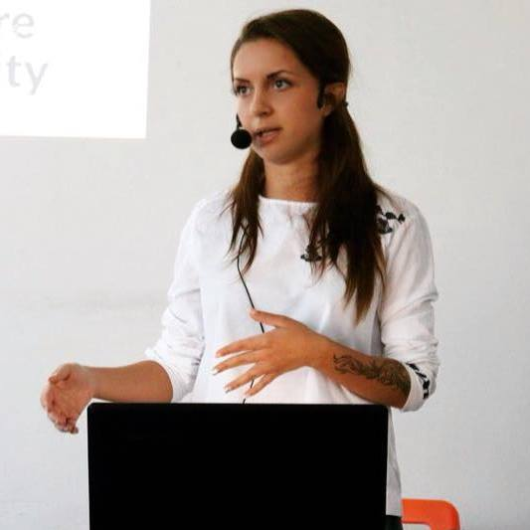
Antonia Atanasova
Experience in JS, HTML5, CSS3, Bootstrap, C#, CMS Systems
Technical Trainer in SoftUni
Web Development Freelancer
Volunteer and Student

Slide 12

Behind the Scenes
The team working on the materials:
Bilqna Borislavova
Hristomir Asenov
Karina Cholakova
Kiril Kirilov
Maya Bratanova
Mladen Raykov
Tanq Staneva

Slide 13

Course Objectives
Course Details and Schedule

Slide 14
Targets of the course
Learn how to manipulate the DOM
Learn the basic syntax in JavaScript
Learn how to work with data types (string, number, object, etc.)
Learn how to store more complicated data (using maps)
Learn how to represent real objects in code

Slide 15

Exam
Structure: 4 problems for 6 hours
Each of the four problems requires DOM knowledge and specifically:
1 - Simple calculations and/or Loops.
2 - Arrays/Matrices - Add/Remove/Sort/Filter.
3 - Strings and Regex - Extract/Manipulate Info from text.
4 - Objects - Sorting, Adding/Removing from object.

Slide 16
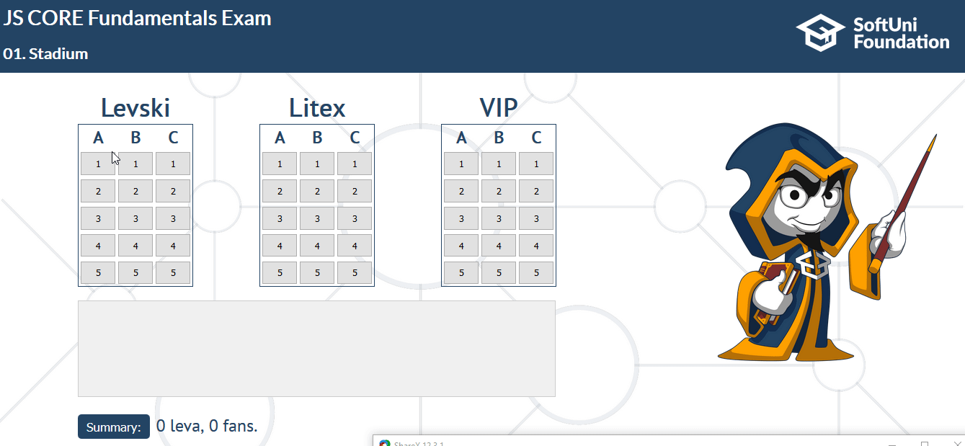
Exam: First Problem Demo

Slide 17
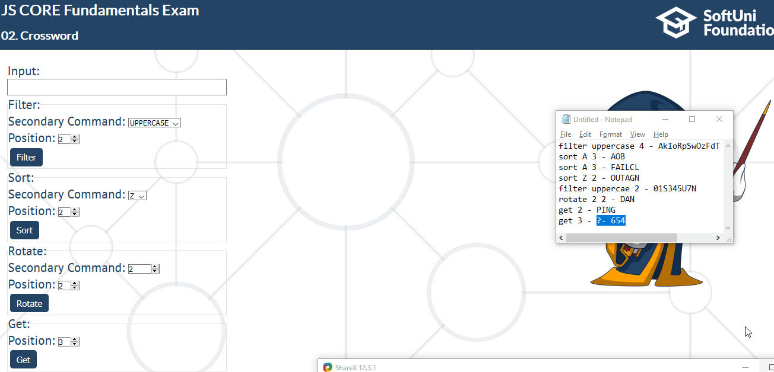
Exam: Second Problem Demo

Slide 18
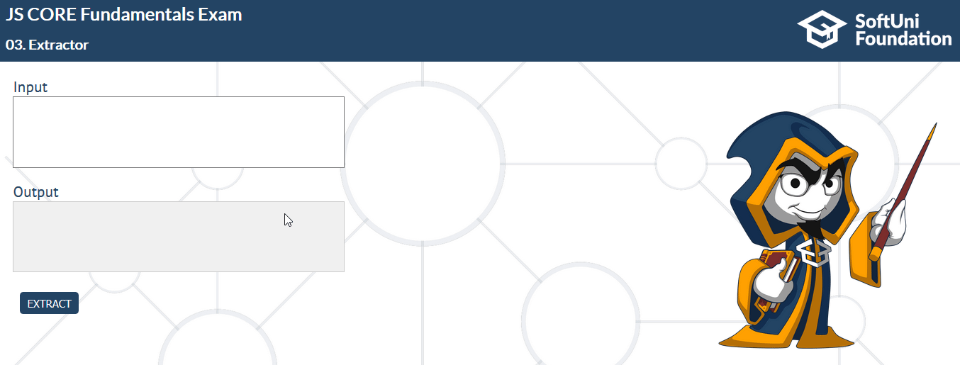
Exam: Third Problem Demo

Slide 19
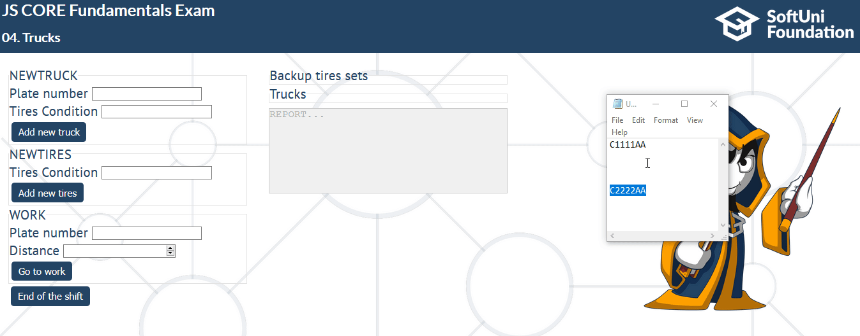
Exam: Fourth Problem Demo

Slide 20

Course Organization

Slide 21

Evaluation Criteria
Mandatory
Final exam – 90%
Exercises/Homework – 10%
Bonuses
Presence in class – 5% bonus
Forum activity – 5% bonus

Slide 22
https://softuni.bg/courses/javascript-fundamentals

Slide 23




Trainings @ Software University (SoftUni)
Software University – High-Quality Education and Employment Opportunities
softuni.bg
Software University Foundation
http://softuni.foundation/
Software University @ Facebook
facebook.com/SoftwareUniversity
Software University Forums
forum.softuni.bg

Slide 24

License
This course (slides, examples, demos, videos, homework, etc.) is licensed under the "Creative Commons Attribution-NonCommercial-ShareAlike 4.0 International" license

